Slide 1

Metro
October 10, 2025
Terrebonne Distribution Center

Slide 2
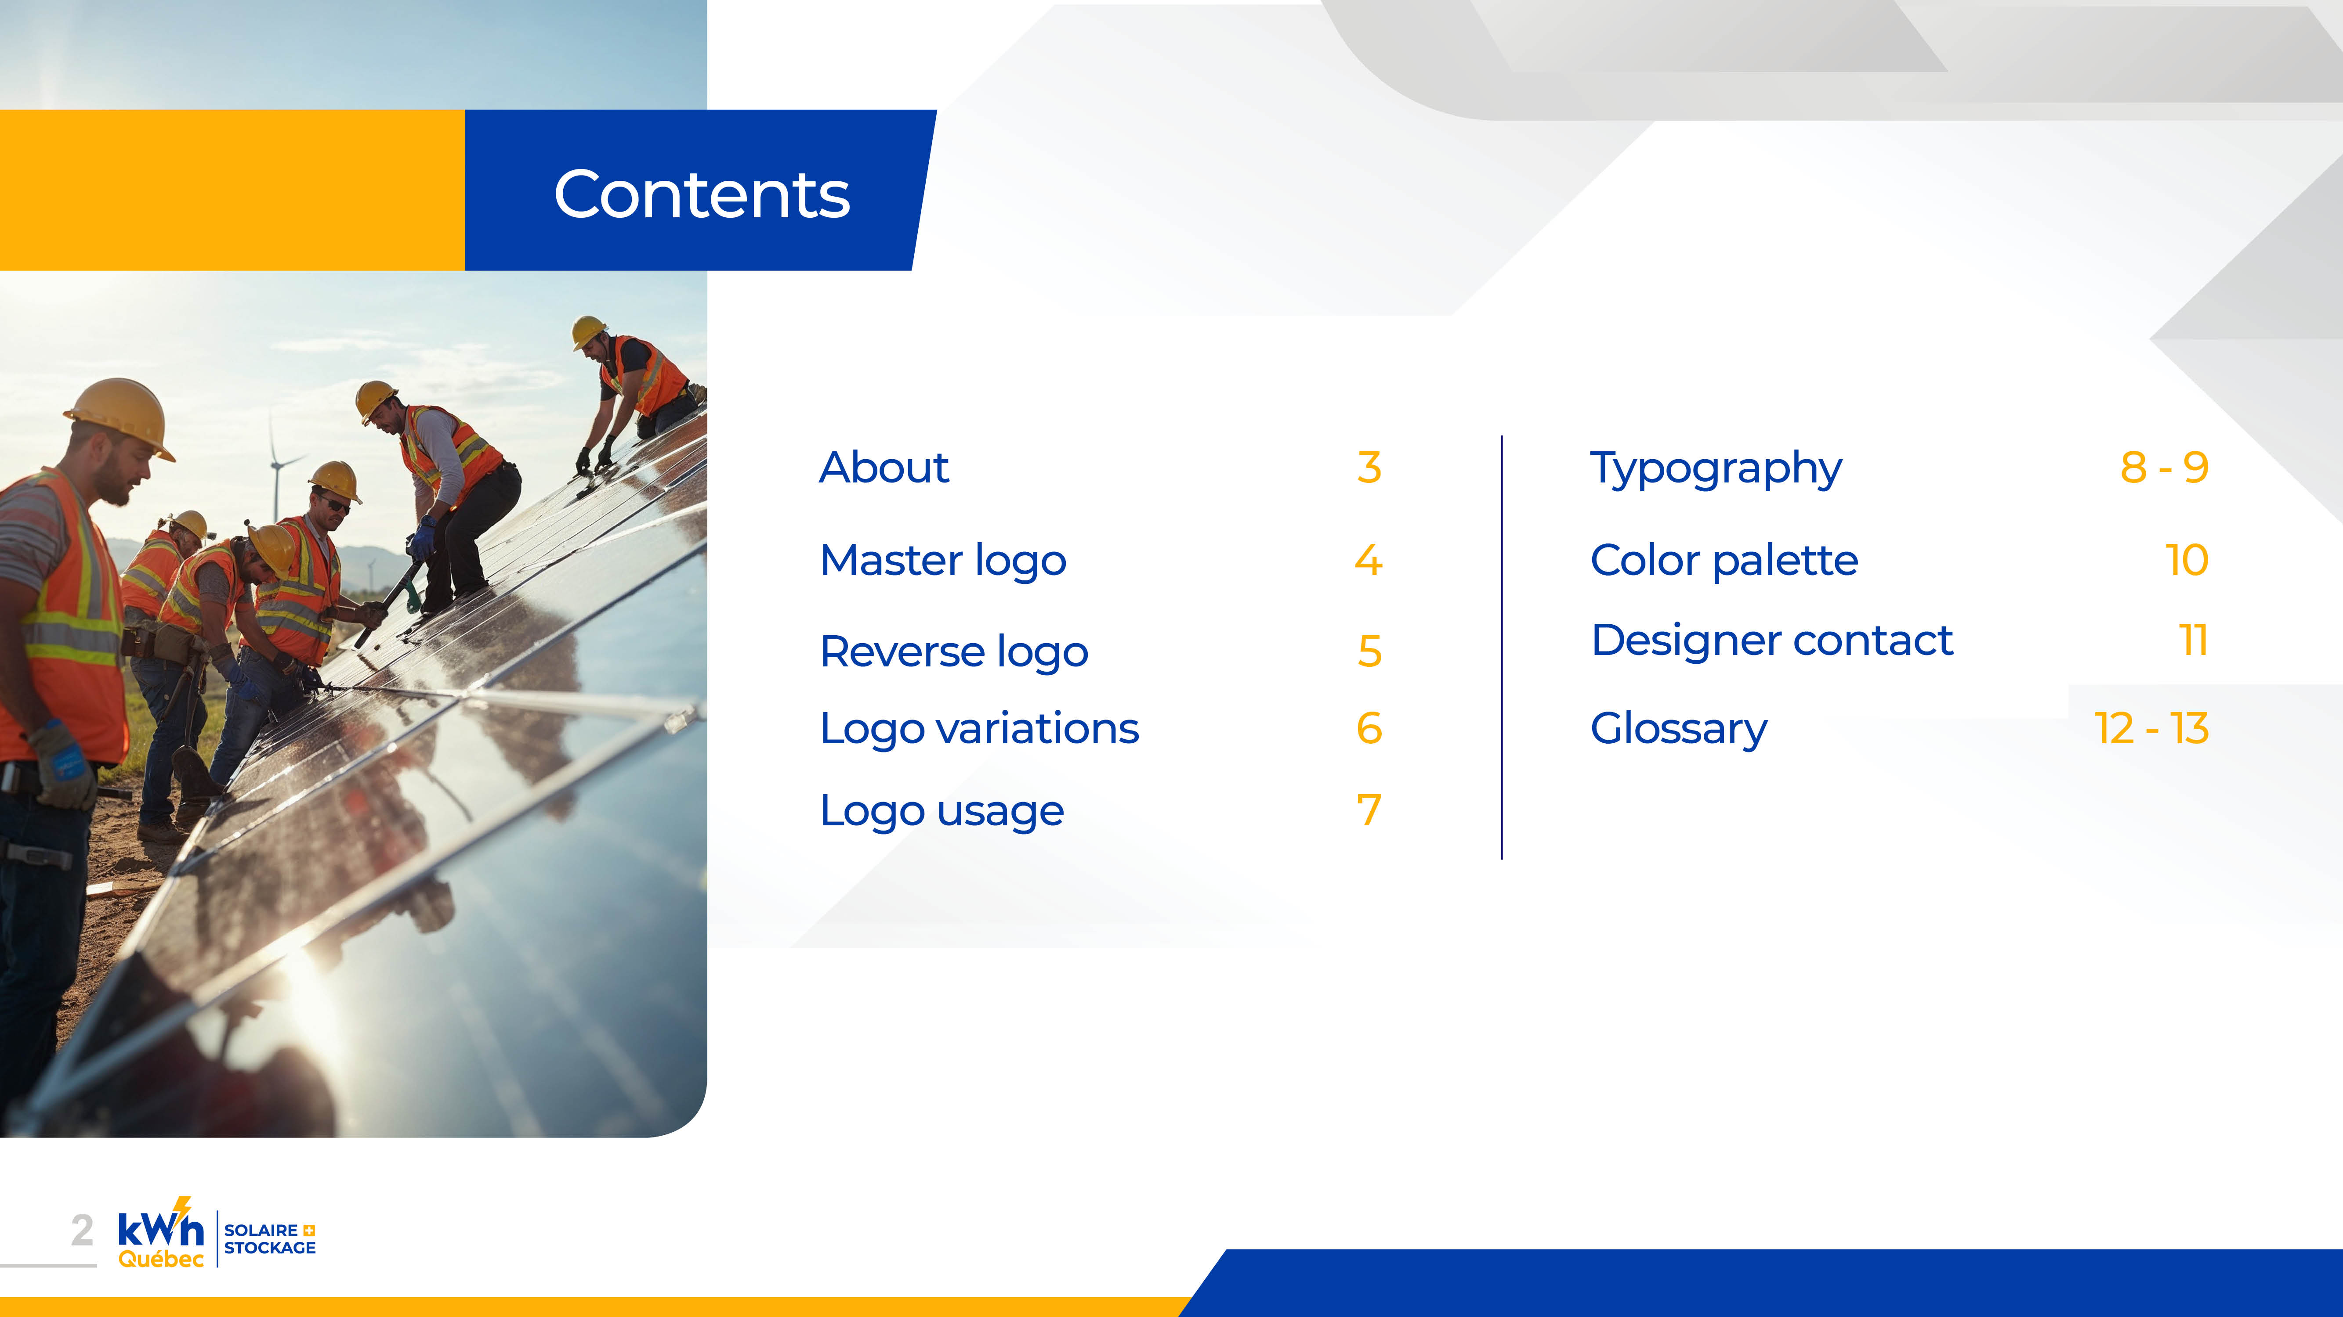
Overview
Potential solar generation: Rooftop + Carports
~7-8 MW
~ 8-9 GWh annual production
Other opportunities
Battery storage
Winter load-shifting
CONFIDENTIEL - kWh Québec inc. © 2025 Tous droits réservés
2

Slide 3

Solar Overview
 | Capacity | Est. Annual Production
A. Rooftop | 4.1 - 5 MW | 5.2 - 5.7 GWh
B. Carport | 2.81 MW | 3.6 GWh
CONFIDENTIEL - kWh Québec inc. © 2025 Tous droits réservés
3

Slide 4
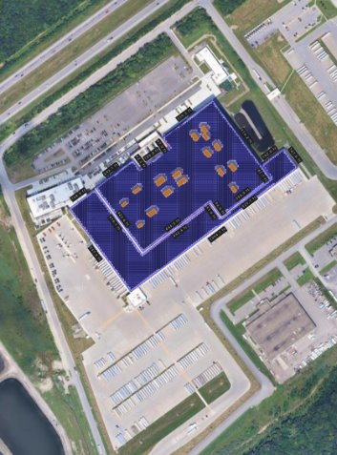
A. Rooftop
System Capacity: 4.1 - 5 MW
Est. Annual Output: 5.2 - 5.7 GWh
CONFIDENTIEL - kWh Québec inc. © 2025 Tous droits réservés
4

Slide 5
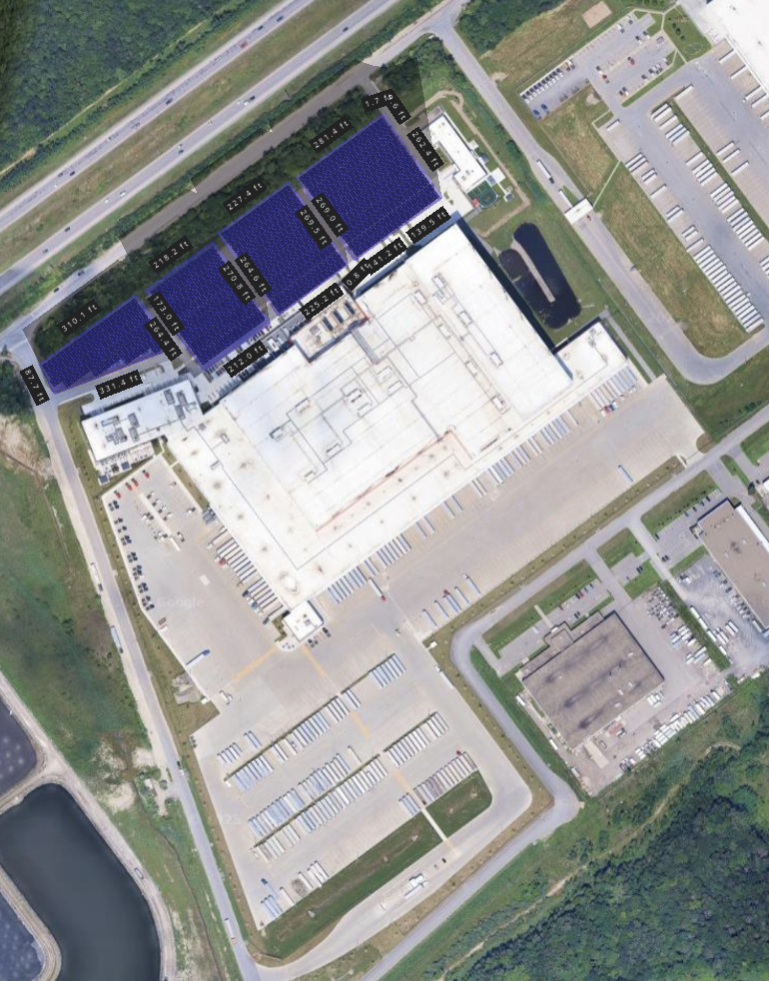
B. Carports
2.81 MW Output
Est. Annual Capacity: 3.6 GWh
CONFIDENTIEL - kWh Québec inc. © 2025 Tous droits réservés
5

Slide 6
Other Opportunities
Potential:
Battery storage
Winter load-shifting
Would require 12 to 24 months per hour energy consumption to understand load profiles and price out opportunities
(available on Hydro Québec’s Online Espace Client)
CONFIDENTIEL - kWh Québec inc. © 2025 Tous droits réservés
6

Slide 7

CONFIDENTIEL - kWh Québec inc. © 2025 Tous droits réservés
7

